Slide 1

SafeSense
A room occupancy detection system
By Jianni Cariaga, Reed Ellison, and Khang Tran
CSULB Spring 2020 - Computer Engineering Senior Project
Notes:
[1/14] Team name, Senior Project CSULB Computer Engineering Spring 2020 announced (5)
[2/14] Names clearly stated (5)

Slide 2
SafeSense Overview
Notes:
1. Summary
2. Motivation
3. Team Roles

Slide 3
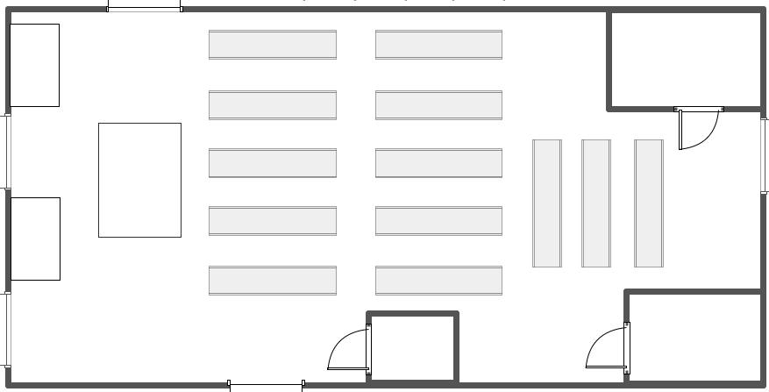

What is SafeSense?
A wirelessly configurable device that utilizes radar technology to detect whether a room is occupied.
Applications
First responder tool
Discreet surveillance
Major Components
60 GHz radar
ESP32 microcontroller
MySQL database
Web application
Notes:
[3/14] Clear concise explanation of what the project is (executive summary) (10)

Slide 4


Motivation for SafeSense
SafeSense was inspired by the invaluable services that firefighters and other first responders perform to ensure the safety of individuals in danger.
Our goal is to develop an effective tool for first responders that will help reduce the overall time spent during indoor emergency protocols.
SafeSense can also be purposed as a discreet surveillance system for home or business owners.
Notes:
[4/14] What was the motivation for the project? Why did you choose it? (10)

Slide 5



Team Roles and Contributions
Khang Tran
Circuit design
Radar configuration
Radar-to-ESP32 serial communication
Reed Ellison
Database design
ESP32 Wi-Fi AP
ESP32-to-database connection
Jianni Cariaga
Web app design
System integration
Web app-to-database connection
Notes:
[5/14] Roles stated. Provide a general overview. After executive summary (10)

Slide 6
Technical Overview
Notes:
1. Hardware Schematic
2. Web Application UI Flowchart
3. Database Relational Schema

Slide 7
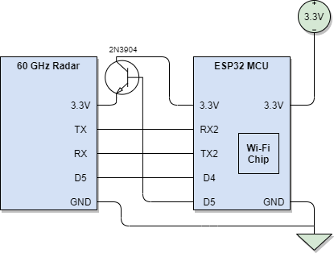
Hardware Schematic
ESP32 Microcontroller Documentation: https://www.espressif.com/sites/default/files/documentation/esp32_datasheet_en.pdf
Notes:
[6/14] High level block diagram of overall project - provides next level detail below executive summary (10)
[7/14] Each section described in some technical detail (10)
[8/14] External resources credited as appropriate for each section described, summary and links provided (10)

Slide 8
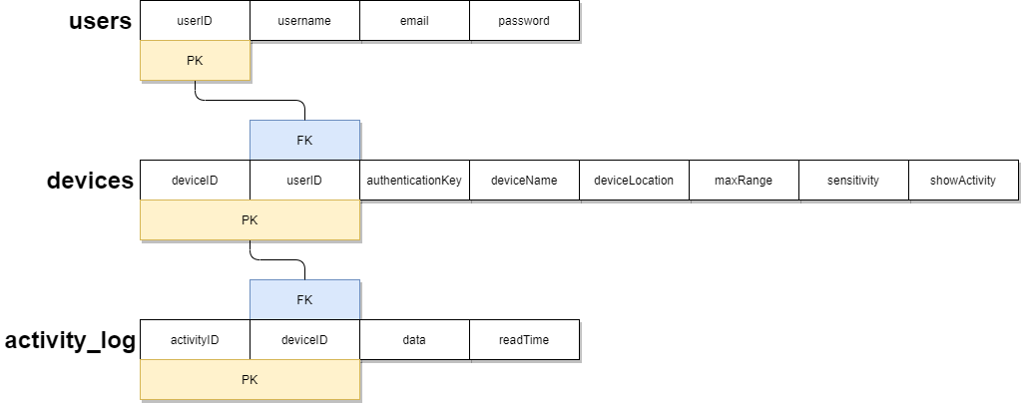
Database Relational Schema
MySQL Connector for Arduino Projects: https://github.com/ChuckBell/MySQL_Connector_Arduino
Notes:
[6/14] High level block diagram of overall project - provides next level detail below executive summary (10)
[7/14] Each section described in some technical detail (10)
[8/14] External resources credited as appropriate for each section described, summary and links provided (10)

Slide 9
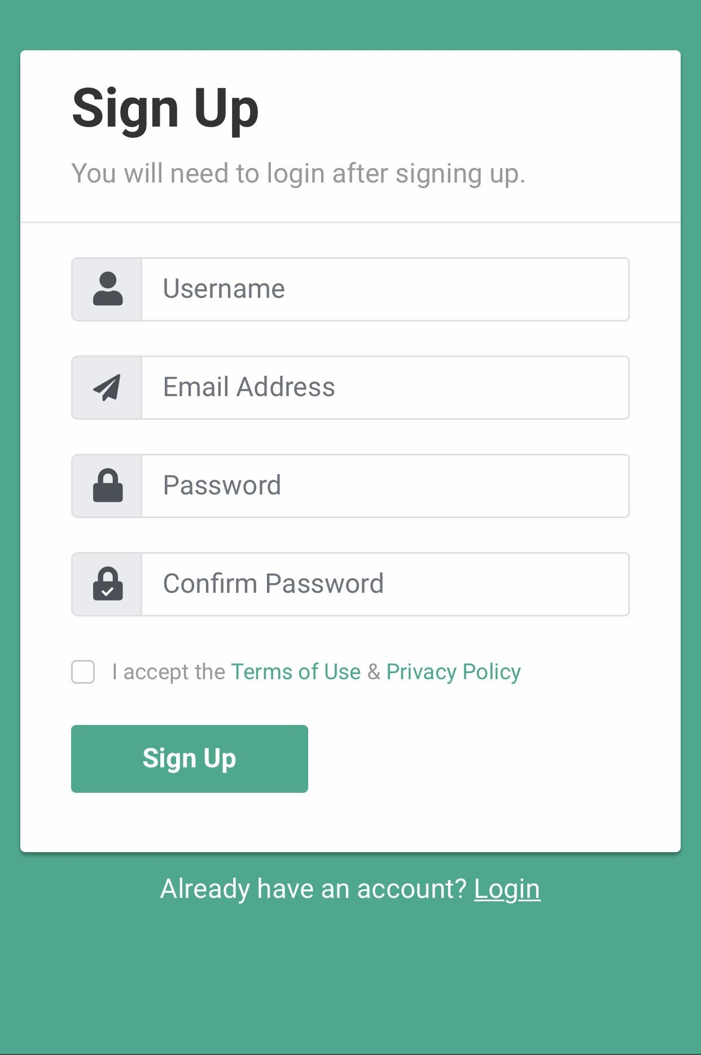
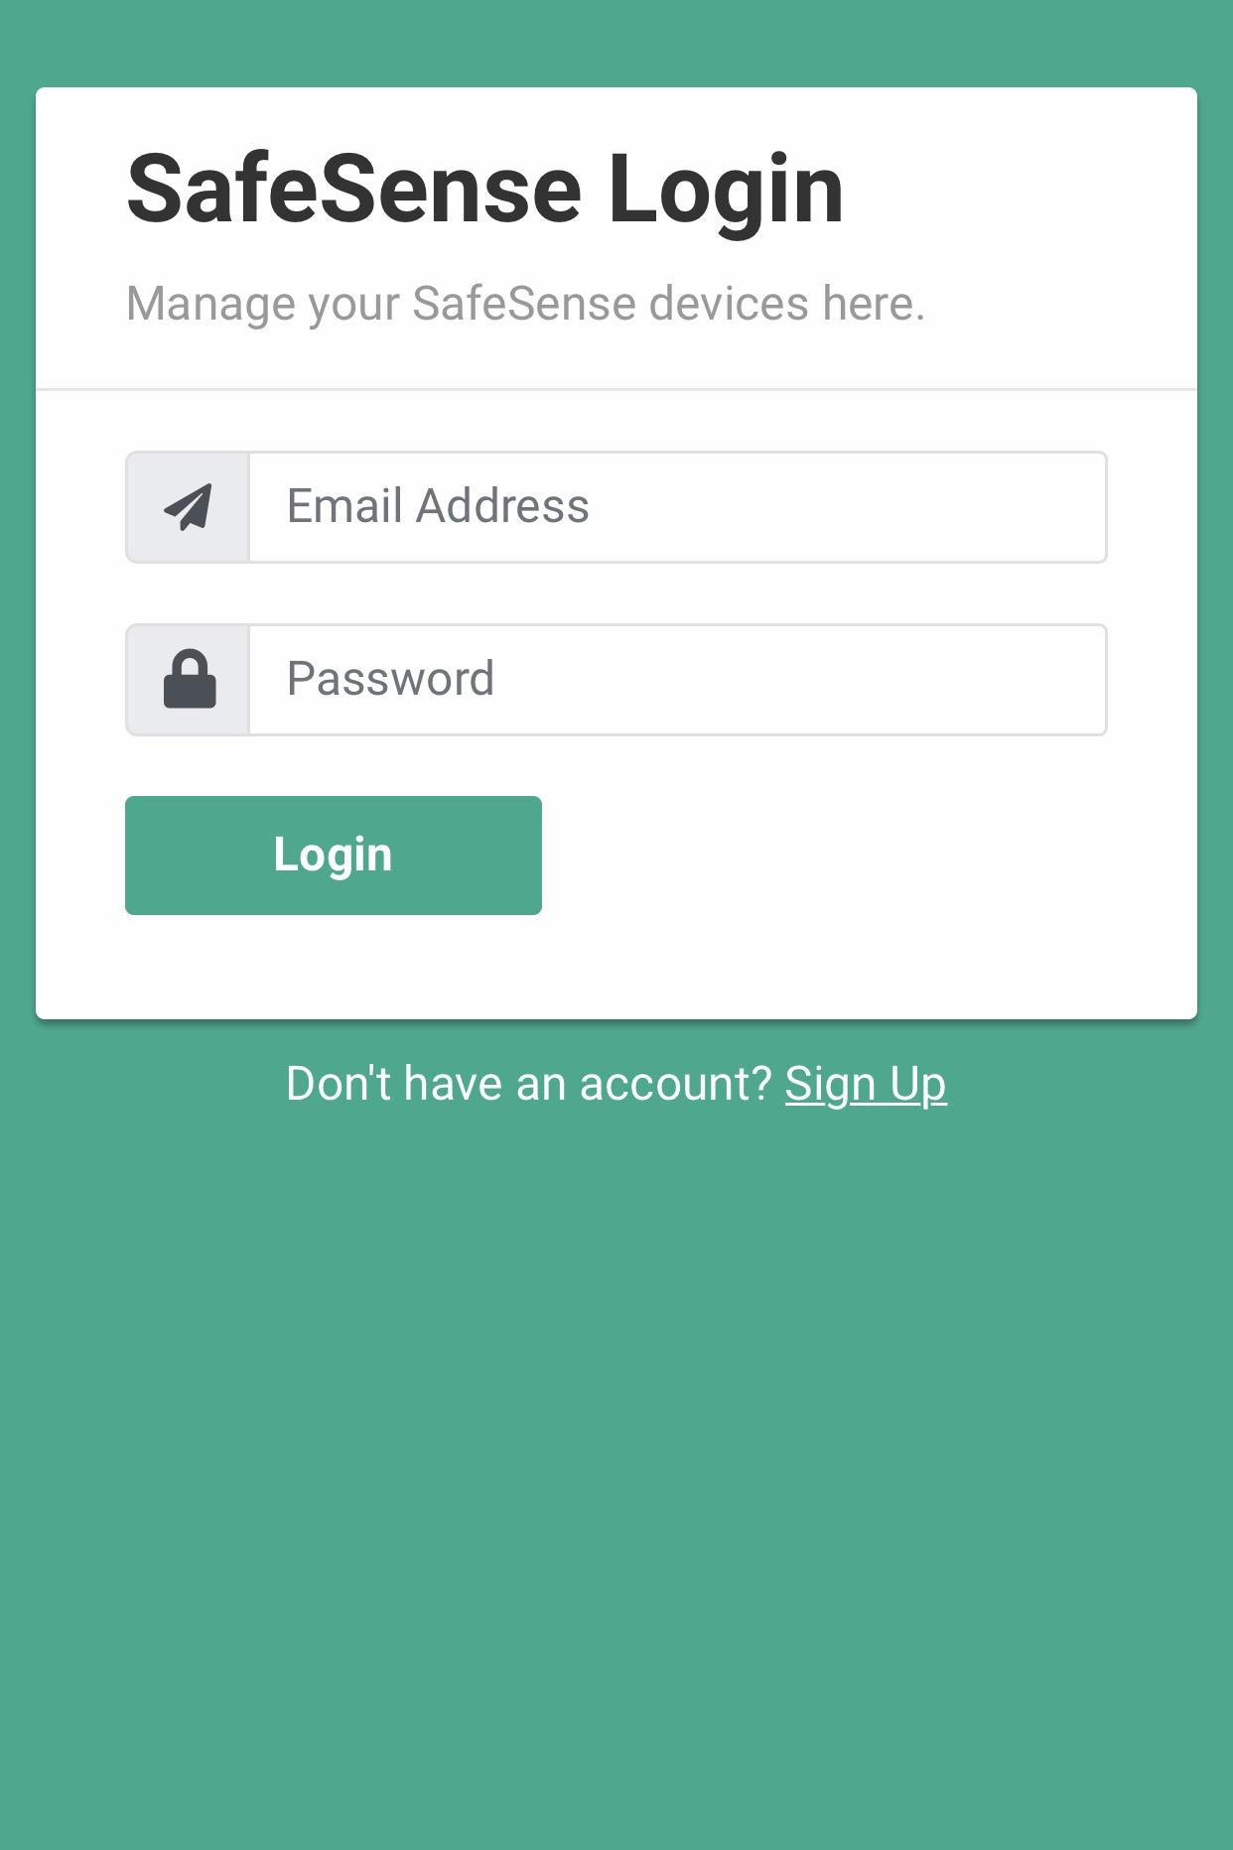
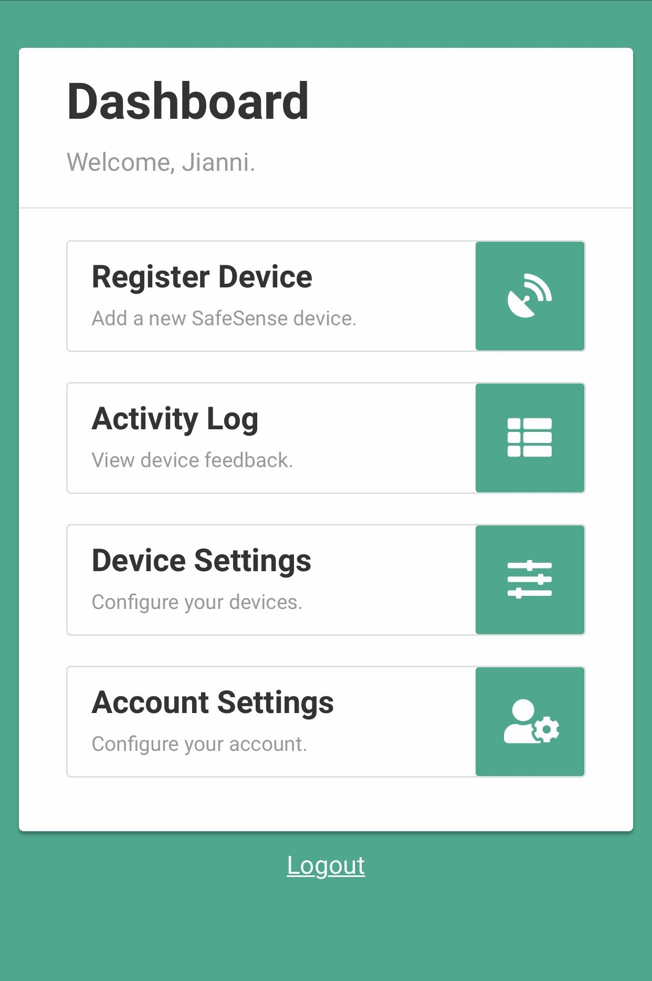
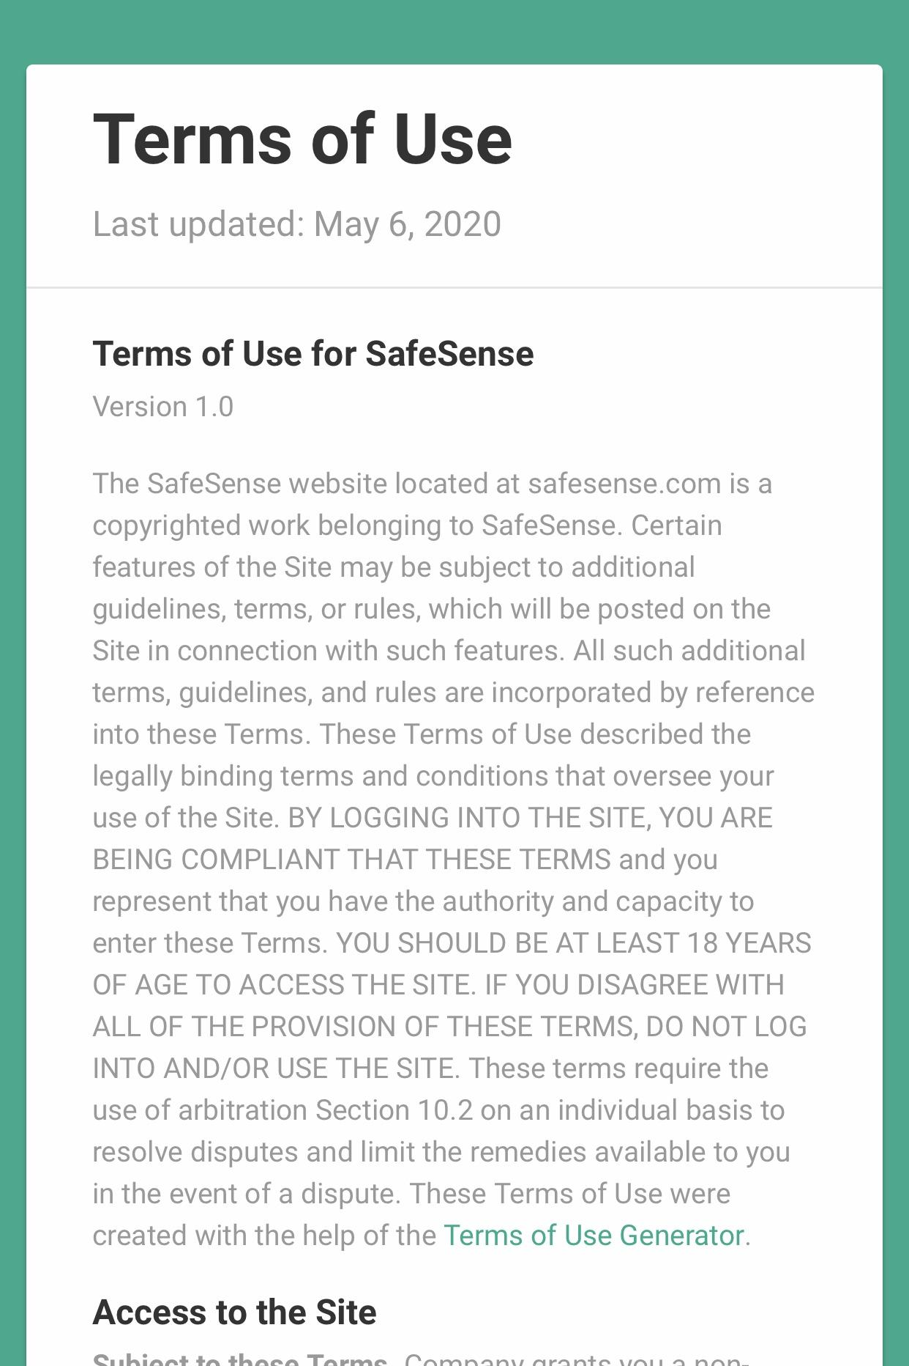
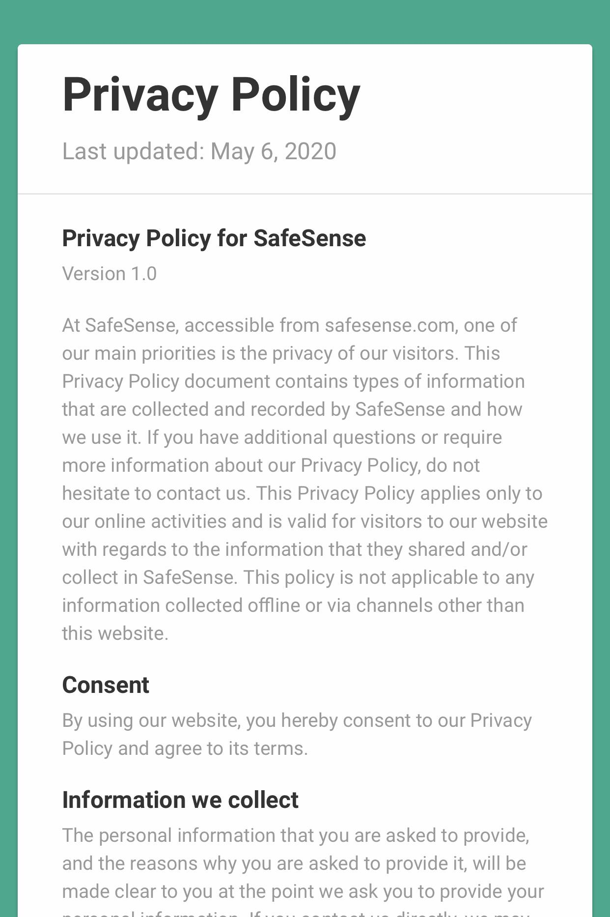
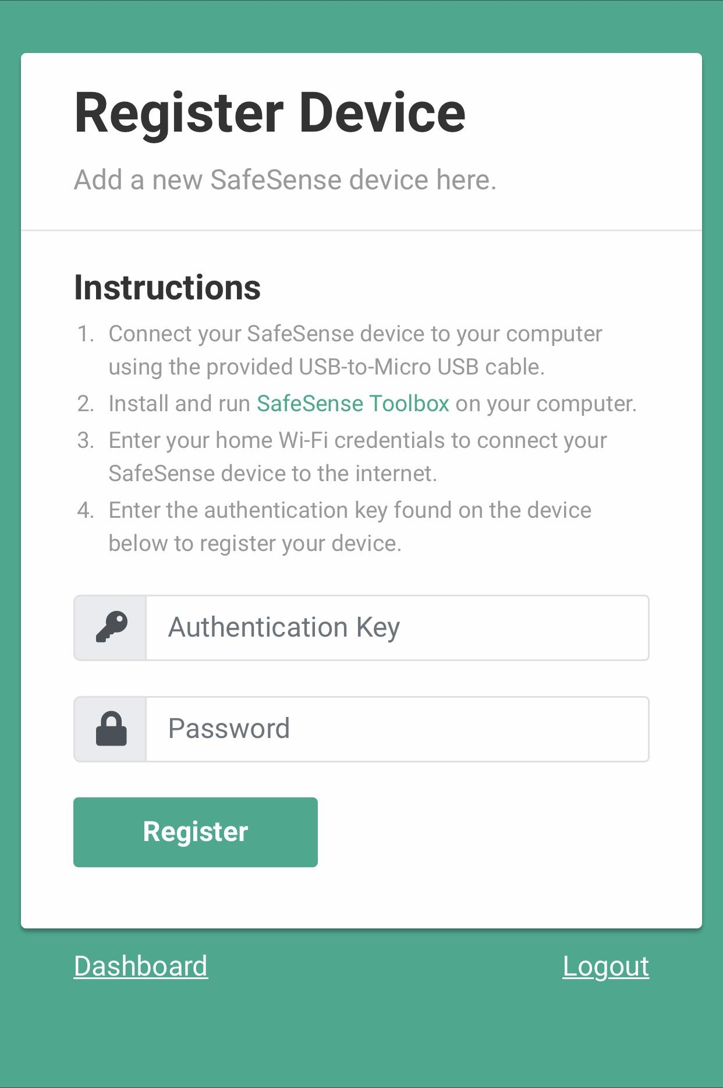
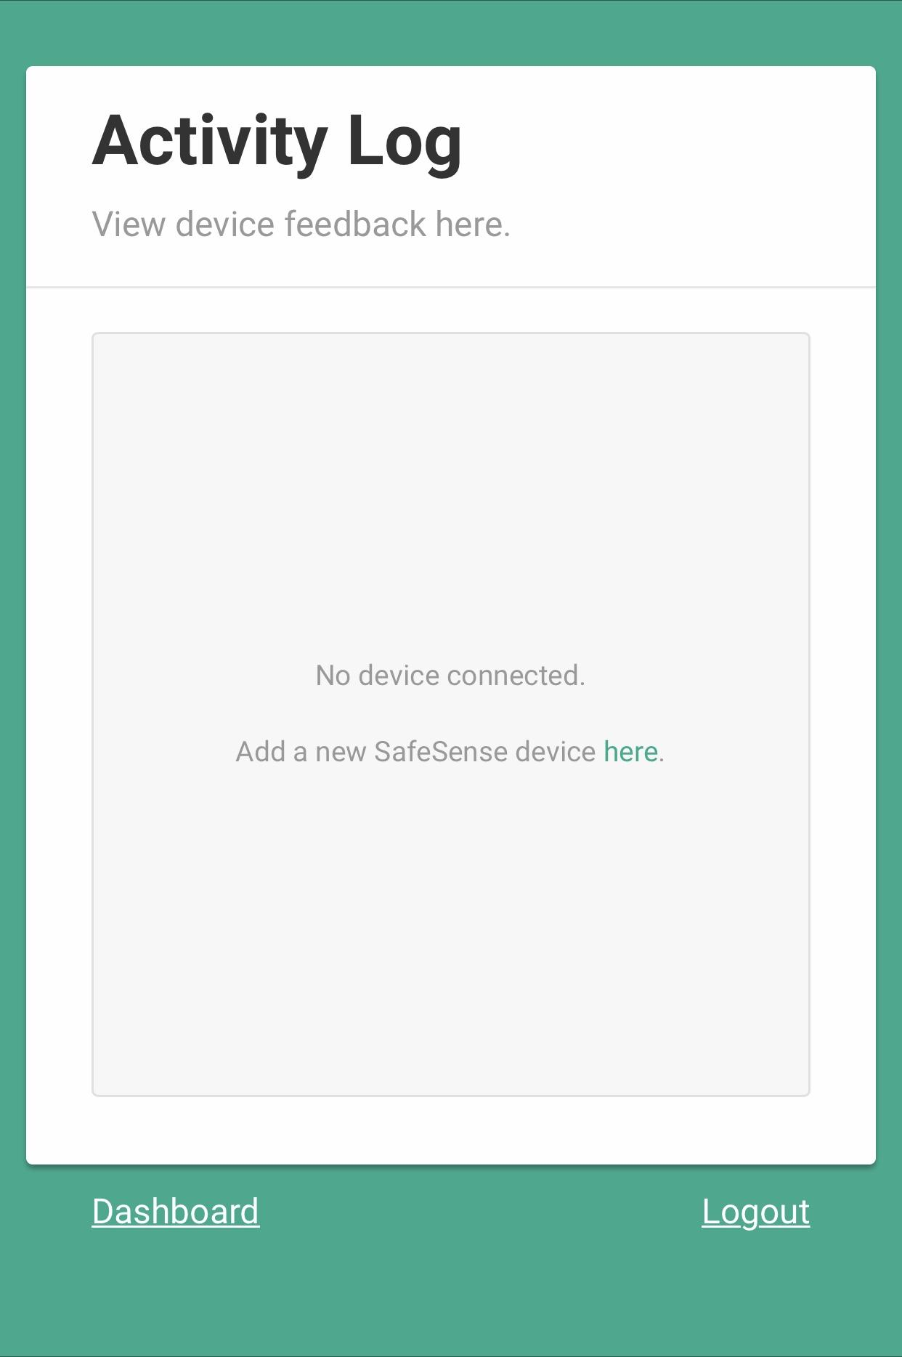
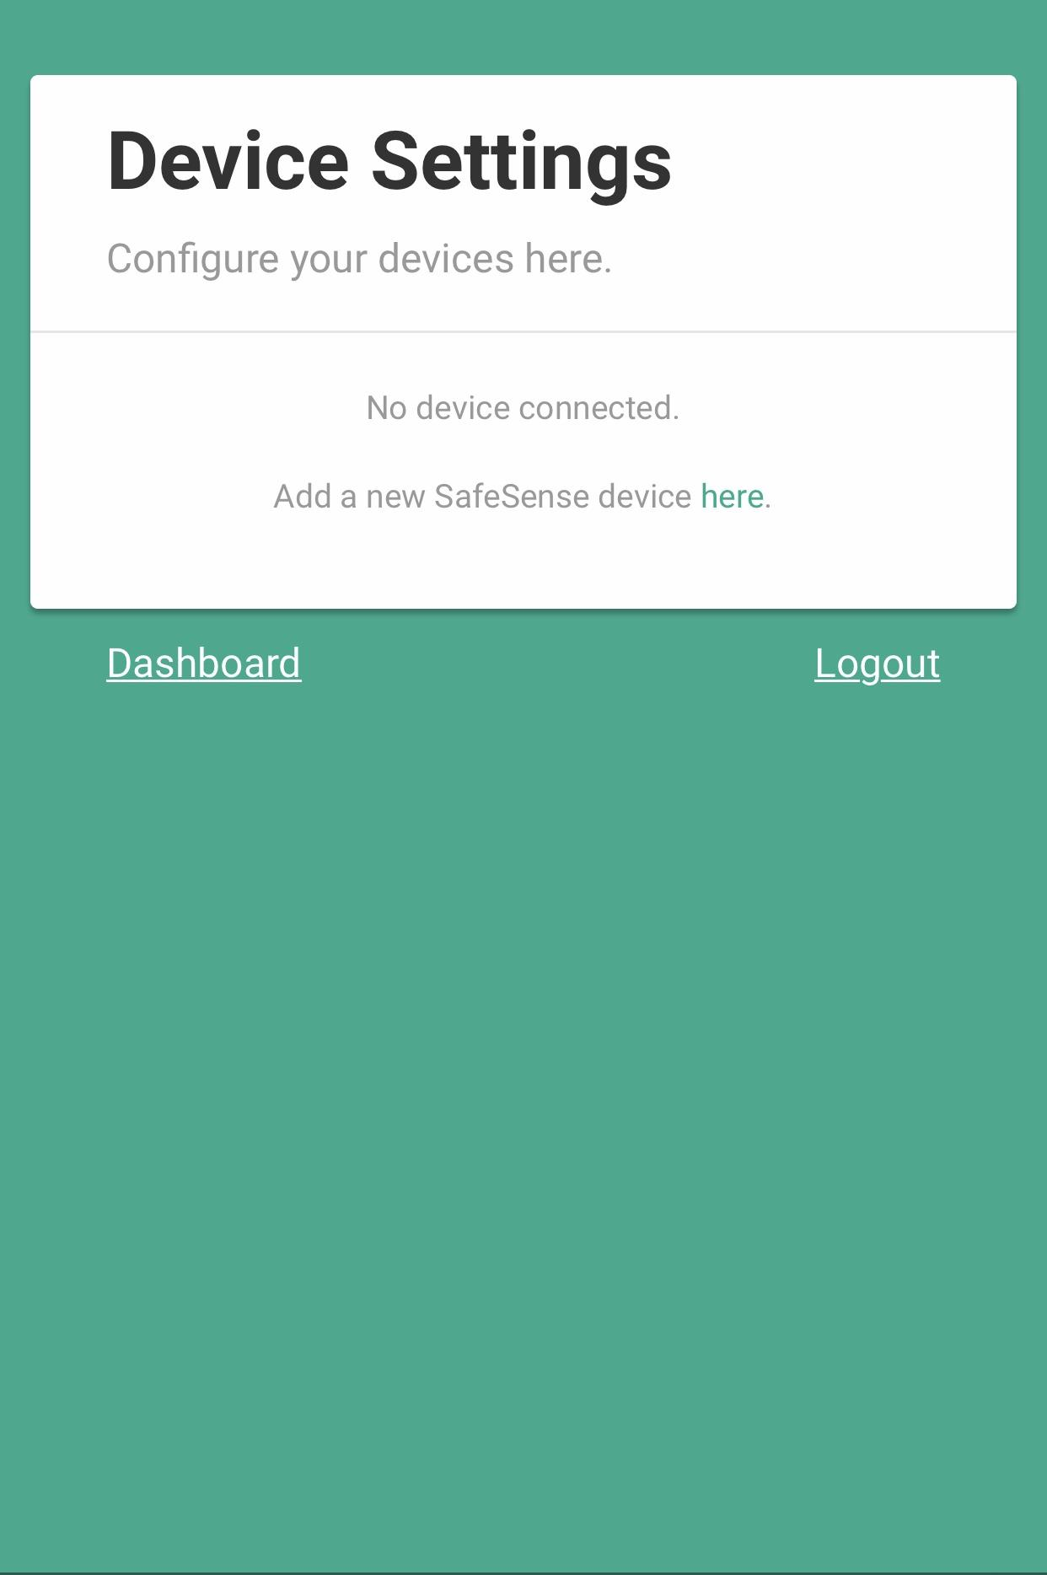
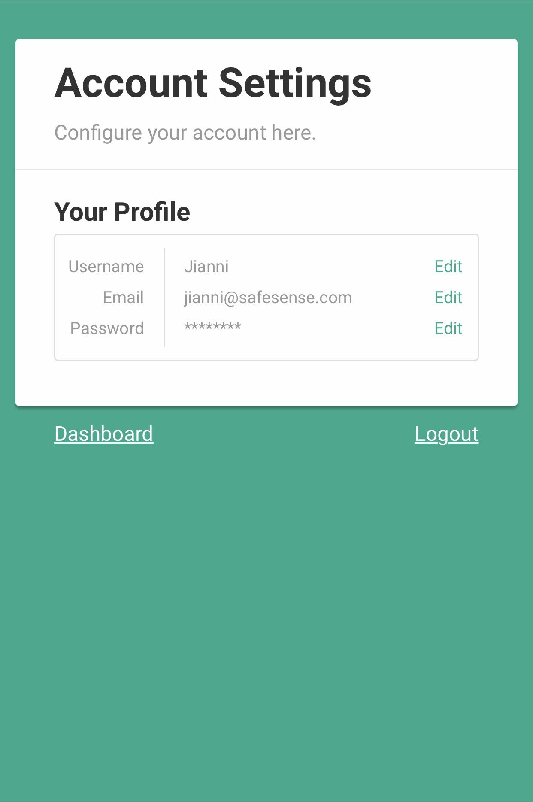
Web Application UI Flowchart
How to Create a Login System in PHP: https://www.youtube.com/watch?v=LC9GaXkdxF8
Notes:
[6/14] High level block diagram of overall project - provides next level detail below executive summary (10)
[7/14] Each section described in some technical detail (10)
[8/14] External resources credited as appropriate for each section described, summary and links provided (10)

Slide 10
Demonstration
Notes:
1. Demo Explanation
2. Live Demonstration
(3. References)

Slide 11

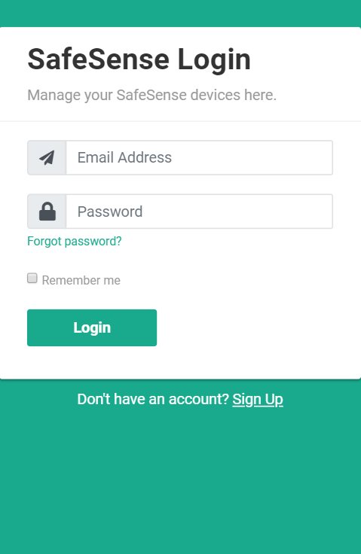
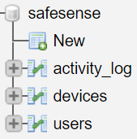
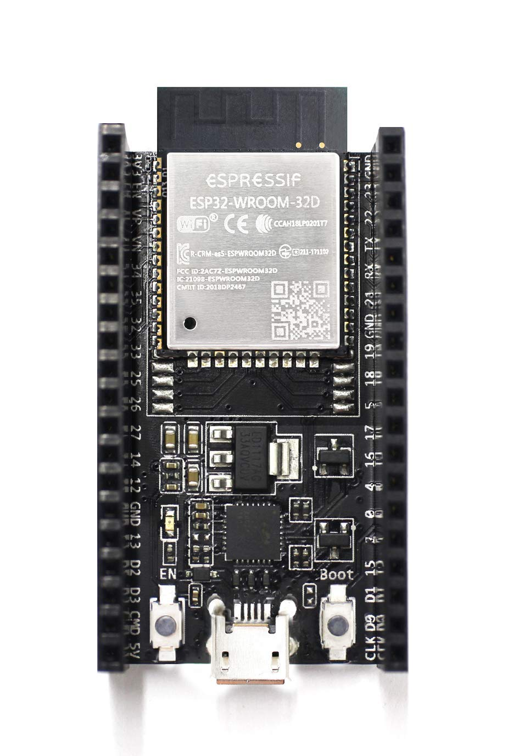
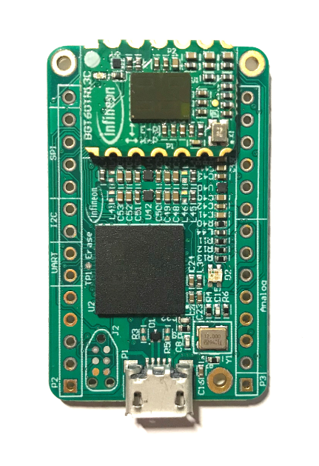
(Partial) Room Occupancy Detection
Demonstration Steps
Create an account/login
Change username
Register a SafeSense device
View device feedback
Change device settings
View device feedback
Notes:
[9/14] Expected behavior explained clearly (20)
[10/14] Demonstration follows what was explained and performs as expected (50)
[11/14] Did the team display an aptitude of Computer engineering skill? (20)
[12/14] Was unique creation clearly presented? (20)

Slide 12
References
Arduino Language Reference
https://www.arduino.cc/reference/en/
BootstrapCDN Reference
https://getbootstrap.com/docs/4.4/getting-started/introduction/
ESP32 Microcontroller Overview
https://www.espressif.com/en/products/hardware/esp32/overview
Flaticon (SafeSense Logo)
https://www.flaticon.com/free-icon/radar_439941?term=radar
Font Awesome (Web App Icons)
https://fontawesome.com/how-to-use/on-the-web/referencing-icons/
How to Create a Login System in PHP
https://www.youtube.com/watch?v=LC9GaXkdxF8
How to Create an ESP32 Wi-Fi Access Point
https://randomnerdtutorials.com/esp32-access-point-ap-web-server/
How to Insert ESP32 Data Into a Database
https://randomnerdtutorials.com/esp32-esp8266-mysql-database-php/
JavaScript Language Reference
https://www.w3schools.com/jsref/
jQuery AJAX Methods
https://www.w3schools.com/jquery/jquery_ref_ajax.asp
MySQL Connector for Arduino Projects
https://github.com/ChuckBell/MySQL_Connector_Arduino
PHP and MySQL Language Reference
https://www.w3schools.com/php/default.asp
SiteGround (Web Hosting Service)
https://www.siteground.com/
XENSIV™ 60 GHz Radar Overview
https://www.infineon.com/cms/en/product/promopages/60GHz/
Notes:
[13/14] References provided on what was not unique work? (10)

Slide 13
Questions?
Notes:
[14/14] Clear, well organized, understandable presentation that was well adapted to on presentation (10)

